Slide 1
Topic Modeling On New York Times Articles
Vinisha Shukla - 16344280
Pavan Pratapagiri - 16343743
Manoj Chirravuri – 16345434
Snigdha Chandaluri - 16352688

Slide 2
MODELS IMPLEMENTED
NMF(Nonnegative matrix factorization)
LSA (Latent Scemantic Analysis)
LDA (Linear discriminant analysis)
BERTopic

Slide 3
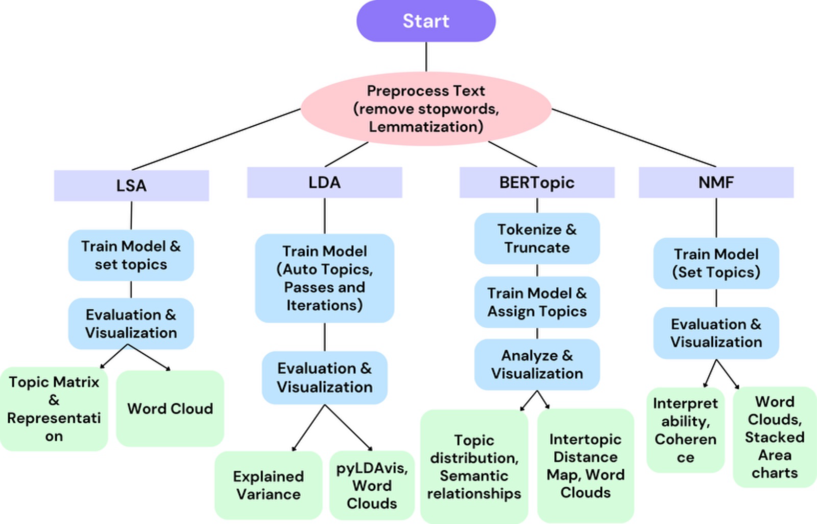
Flow Diagram Of Methodologies Used
The flowchart outlines the process of comparing four topic modeling algorithms on New York Times articles.
After preprocessing, each algorithm follows a specific path: LSA and NMF require a set number of topics, LDA determines it automatically, and BERT Topic identifies topics without input. E
valuation techniques assess topic quality, leading to a comparative analysis to determine the most effective method.

Slide 4
Data Pre-Processing
Data Extraction: The code extracts URLs and content from a text file containing articles.
URL Parsing and Content Structuring: Extracting dates, news categories, and headlines from URLs, enabling structured data organization and facilitating chronological, categorical, and concise representation of the content.
Text file converted to CSV file

Slide 5
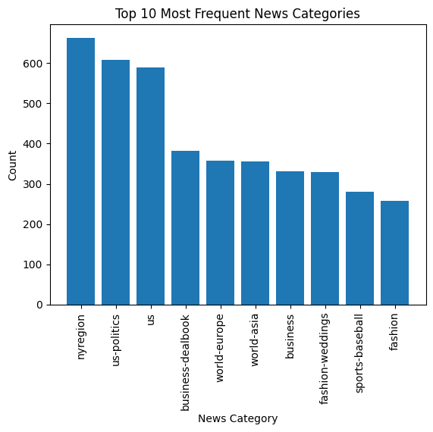
Data Pre-Processing
Data Organization: The extracted information is structured into a DataFrame for efficient handling.
Data Analysis Possibilities: The DataFrame enables various analyses, such as trend analysis over time and category-wise content analysis.
Text Preprocessing: NLTK stopwords are used to remove irrelevant words from the content.
Top 10 Most Frequent News Categories

Slide 6
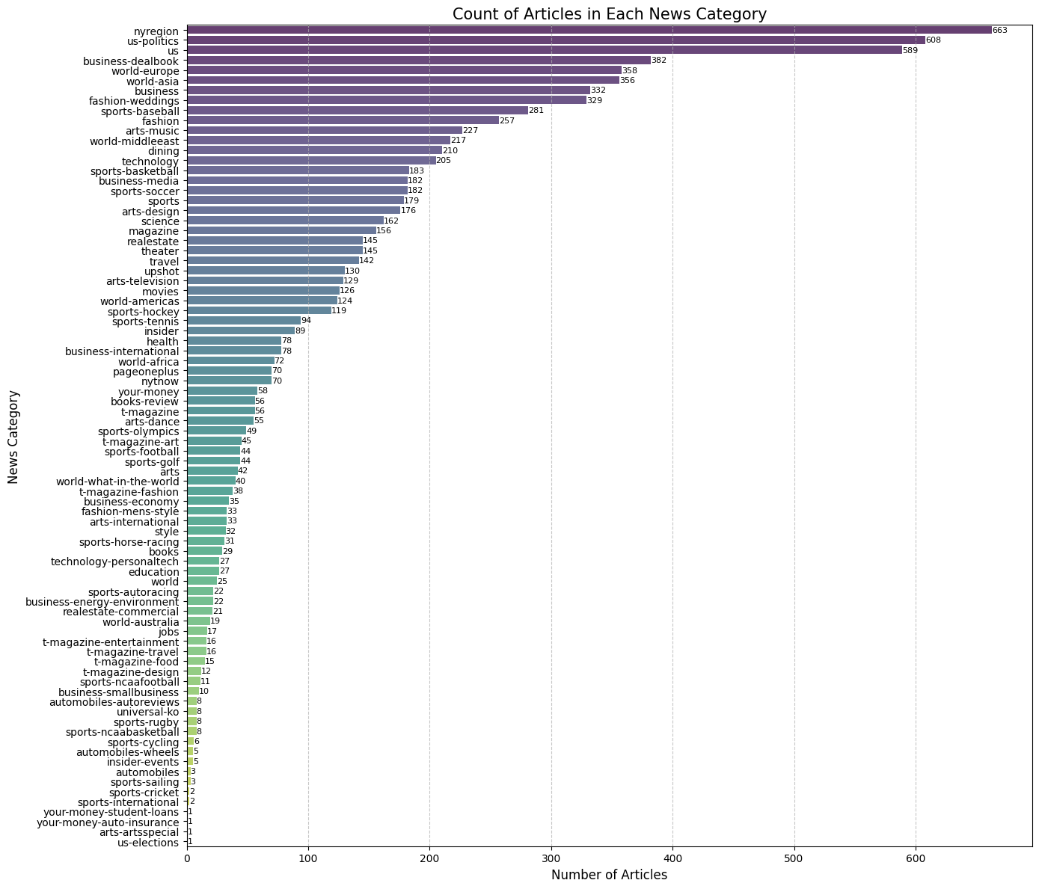
Data Pre-Processing
Visualization Potential: The extracted data can be visualized using matplotlib and seaborn for insights and presentation purposes.
Application Scenarios: The code can be applied to analyze news trends, identify popular categories, and extract key information from articles.
Flexibility and Scalability: The code can be adapted and scaled to handle larger datasets and perform more complex analyses.
Count of articles in each news category

Slide 7
NMF(Nonnegative matrix factorization)
Modelling with nmf: By applying NMF to a TF-IDF matrix generated from the text data, latent topics within the corpus are discovered, aiding in uncovering underlying themes and patterns.
Visualization of the topics:This visualization of topics allows for a clear understanding of the main themes present in the text data, aiding in interpretation and analysis.

Slide 8
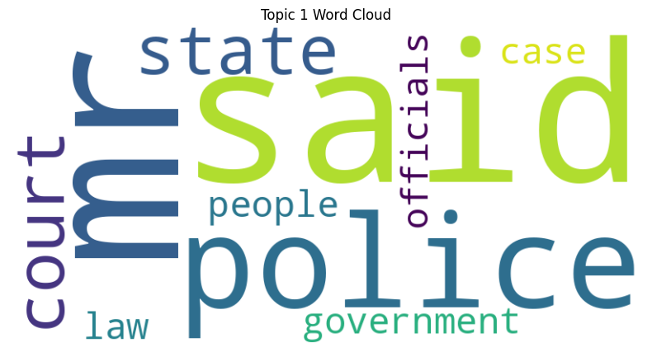
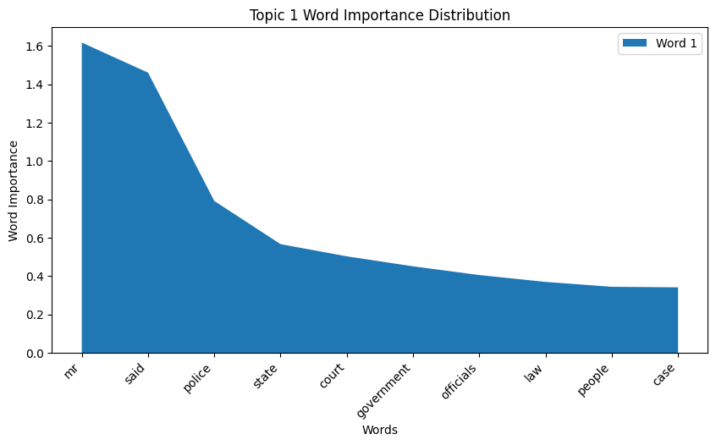
NMF(Nonnegative matrix factorization)
Word Cloud Visualization: This code efficiently generates word clouds, offering a visual representation of the most prominent terms within each topic, aiding in topic interpretation and understanding..
Stacked Area Chart: This code generates stacked area charts for each topic extracted by NMF, illustrating the distribution of word importance scores among the top words, facilitating insight into the significance of individual terms within topics.

Slide 9
LSA (Latent Scemantic Analysis)
TF-IDF Vectorization: Text is vectorized using TF-IDF (Term Frequency-Inverse Document Frequency) vectorization to represent its importance in each document.
Topic Modeling:LSA is applied to the TF-IDF matrix to identify underlying topics in the corpus.

Slide 10
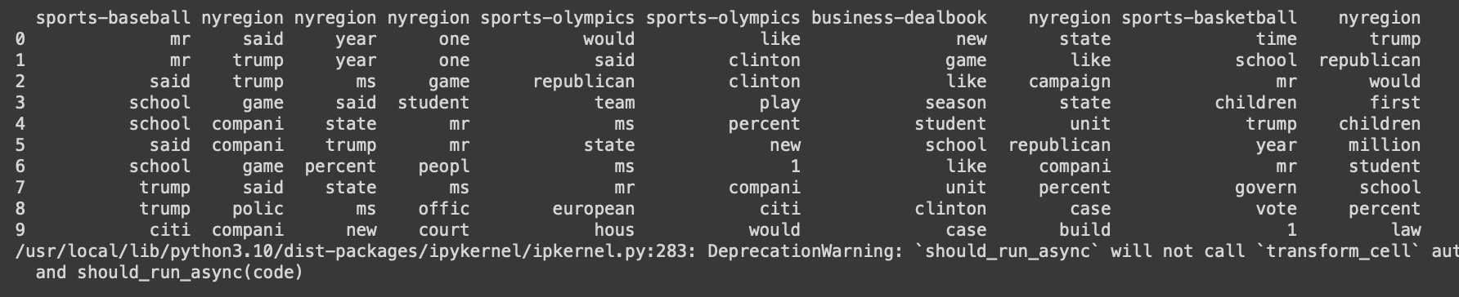
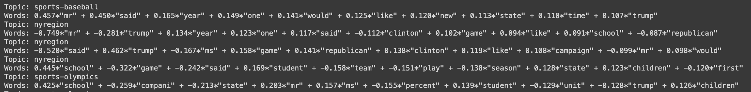
LSA (Latent Scemantic Analysis)
Topic-Word Matrix: A matrix is created to display the top words for each topic, providing a concise overview of the main themes
Topic Representation: Topics are represented by a set of words with associated weights, showcasing the key terms defining each topic.

Slide 11
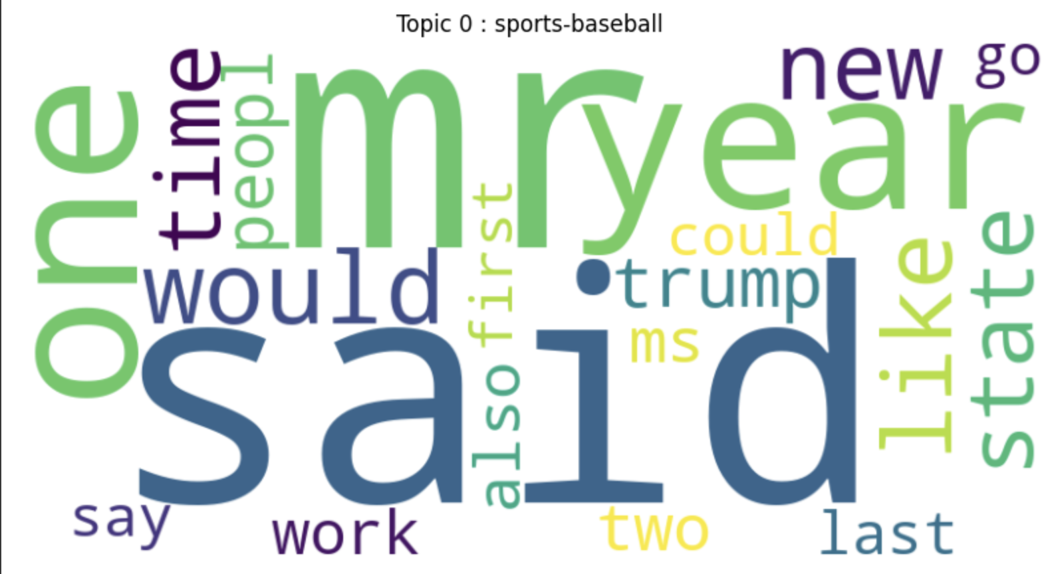
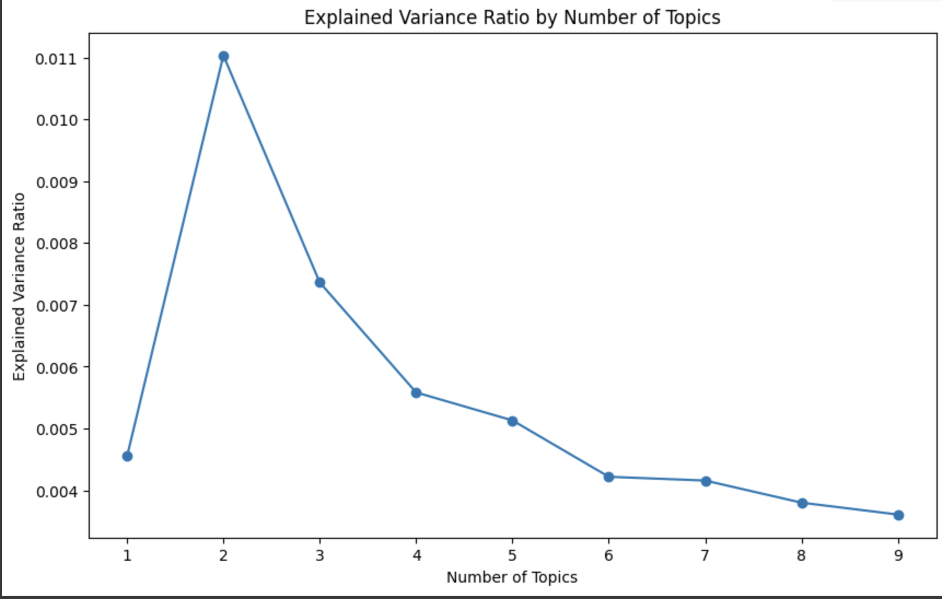
LSA (Latent Scemantic Analysis)
Word Cloud Visualization: Word clouds are generated for each topic, visually representing the most significant terms in the topic.
Explained Variance Ratio Plot: The explained variance ratio is plotted against the number of topics to understand how much of the variance in the data is explained by the topics.

Slide 12
LDA (Linear discriminant analysis)
Dictionary and Corpus Creation: Construct a dictionary mapping words to unique IDs and create a corpus representing the document collection.
Model Training: Train the LDA model on the prepared corpus, iteratively assigning words to topics based on statistical distributions.
Interpret Topics: Analyze the learned topics and associated word distributions to understand the underlying themes captured by the model.

Slide 13
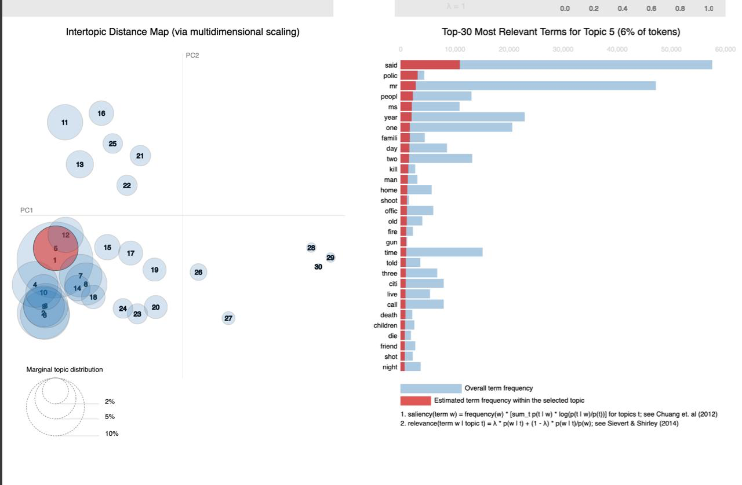
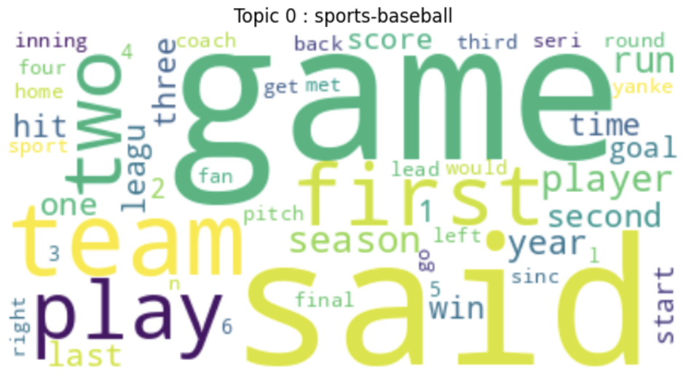
LDA (Linear discriminant analysis)
PyLDAvis offers an interactive visualization of topic modeling results, aiding in the exploration of topic-term distributions and inter-topic relationships.
Word clouds visually represent the most significant terms within each topic, facilitating intuitive understanding of the dominant themes in the corpus.

Slide 14
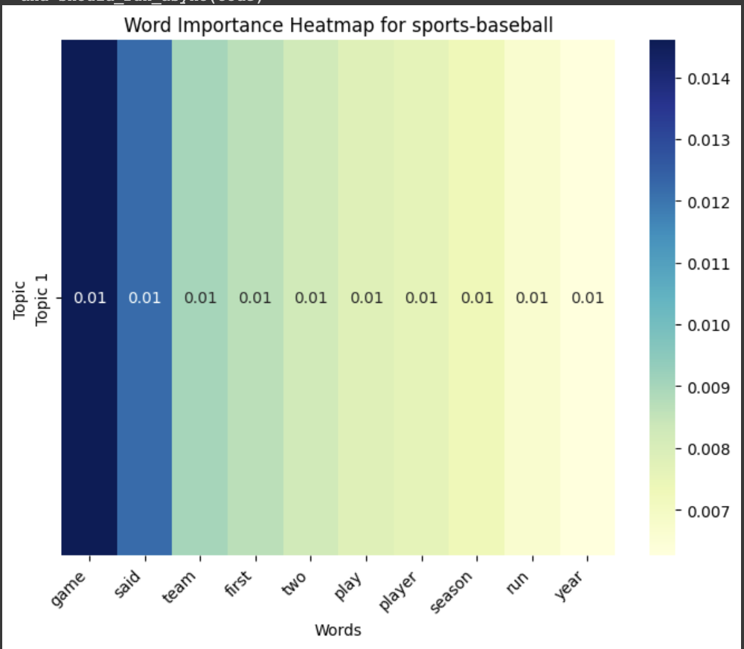
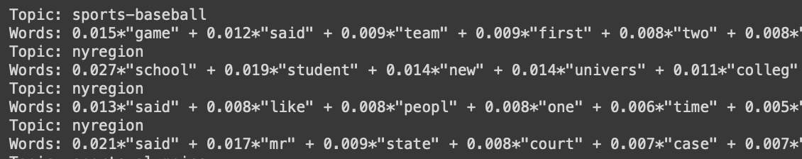
LDA (Linear discriminant analysis)
This heatmap showcases the importance of words in each topic, enabling a quick grasp of the key terms defining each topic's content.
Each topic is represented by a set of key words along with their corresponding weights, offering insights into the main themes discussed within each topic.

Slide 15
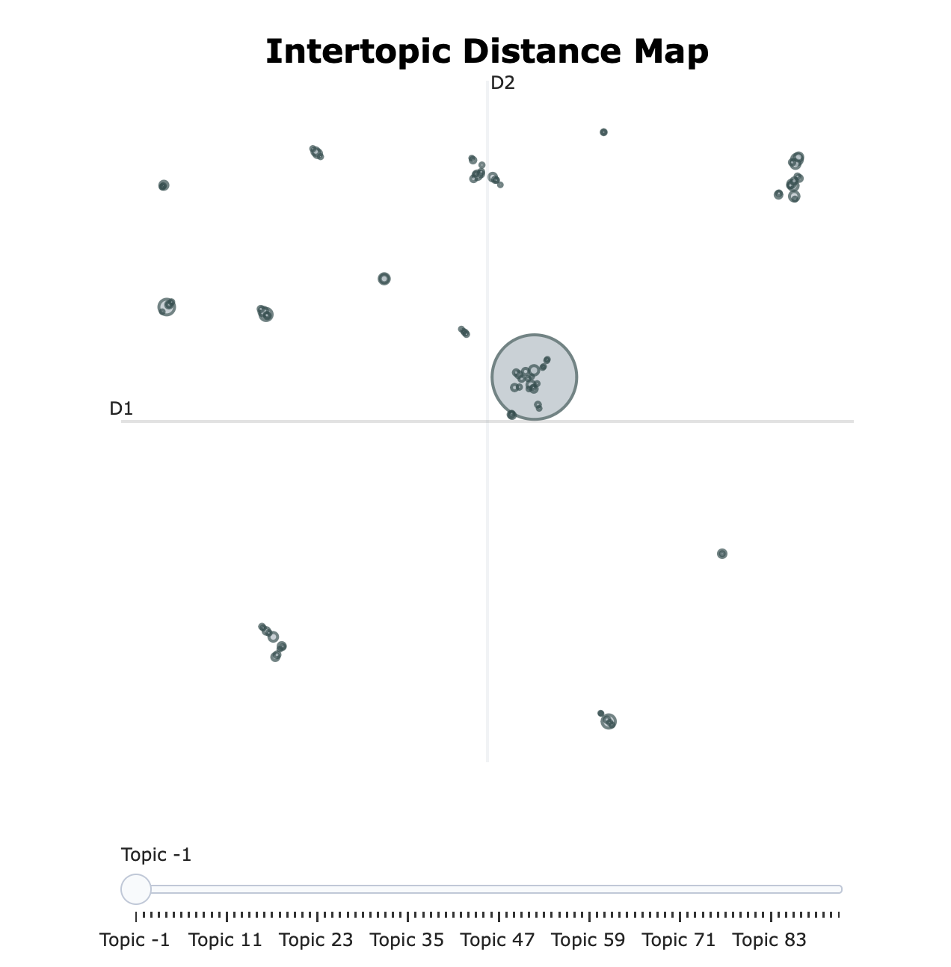
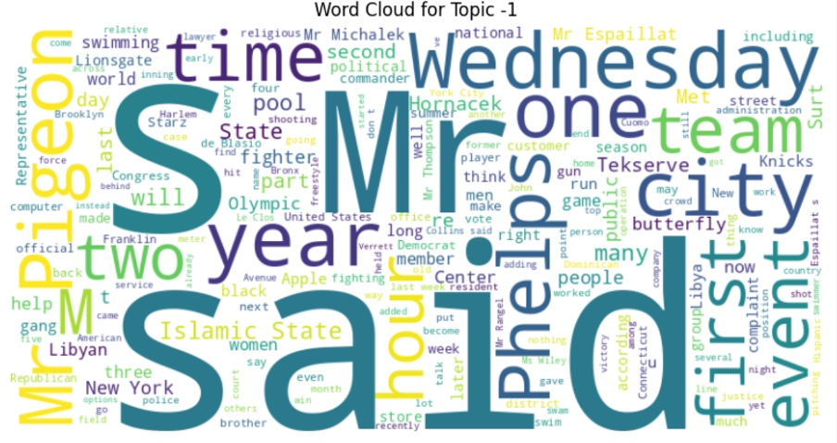
BERTopic
Tokenization with BERT Tokenizer: Convert articles to token IDs using BERT tokenizer, enforce maximum sequence length for consistency.
Topic Modeling with BERTopic: Initialize and fit BERTopic model to assign topics to articles, excluding uncertain assignments.
word clouds to display frequent words in each topic
Intertopic Distance Map

